Slide 1
Instructor Notes
To the instructor:
This slide set has been prepared with both the highlights from the student text as well as notes from the text. The students will not be able to see the notes unless you provide them with the slide set. You can choose whether to provide that option.
The notes are best seen by directing the main presentation to the LCD projector and keeping the Notes view open on the instructor’s PC. You will find that stopping the presentation to do some kind of activity at least once every 20 minutes is critical to keeping PowerPoint from become tedious. Since different people have different presenting styles, it would be impossible to provide a clear timing structure. You should allow ample time for each slide, including stopping for activities.
In case you have not done this before, the instructor notes are found by pointing at Slide Show on the Menu Bar. Click on the Set Up Slide Show option and select Multiple Monitors → Show Presenter View.
Note: Presenter View also has a blackout button. Don’t be afraid to use it to interrupt the tedium of staring at an LCD presentation when doing activities.

Slide 2
Advanced AndroidTM Application Development, Fourth Edition Chapter 22 Developing Android 2D Graphics Applications

Slide 3
Chapter 22 Overview
Drawing on the Screen
Working with Text
Working with Bitmaps
Working with Shapes
Leveraging Hardware Acceleration Features

Slide 4
Drawing on the Screen
With Android, we can display images such as PNG and JPG graphics as well as text and primitive shapes to the screen.
We can paint these items with various colors, styles, and gradients and modify them using standard image transforms.
We can even animate objects to give the illusion of motion.

Slide 5
Working with Canvases and Paints
To draw to the screen, you need a valid Canvas object.
Typically, we get a valid Canvas object by extending the View class for our own purposes and implementing the onDraw() method.

Slide 6
Working with Canvases and Paints
private static class ViewWithRedDot extends View {
public ViewWithRedDot(Context context) {
super(context);
}
@Override
protected void onDraw(Canvas canvas) {
canvas.drawColor(Color.BLACK);
Paint circlePaint = new Paint();
circlePaint.setColor(Color.RED);
canvas.drawCircle(canvas.getWidth()/2,
canvas.getHeight()/2,
canvas.getWidth()/3, circlePaint);
}
}
Notes:
For example, here’s a simple View subclass called ViewWithRedDot. We override the onDraw() method to dictate what the View looks like; in this case, it draws a red circle on a black background.

Slide 7
Working with Canvases and Paints
setContentView(new ViewWithRedDot(this));
Notes:
We can then use this View like any other layout. For example, we might override the onCreate() method in our Activity with the code shown here.

Slide 8
Working with Canvases and Paints
Notes:
The resulting screen looks something like this figure. The ViewWithRedDot view draws a red circle on a black background.

Slide 9
Understanding the Canvas Object
The Canvas (android.graphics.Canvas) object holds the draw calls, in order, for a rectangle of space.
There are methods available for drawing images, text, and shapes and support for clipping regions.
The dimensions of the Canvas are bound by the container View.
You can retrieve the size of the Canvas using the getHeight() and getWidth() methods.

Slide 10
Understanding the Paint Object
In Android, the Paint (android.graphics.Paint) object stores far more than a color.
The Paint class encapsulates the style and complex color and rendering information that can be applied to a drawable such as a graphic, shape, or piece of text in a given Typeface.

Slide 11
Working with Paint Color
Paint redPaint = new Paint();
redPaint.setColor(Color.RED);
Notes:
You can set the color of the Paint using the setColor() method. Standard colors are predefined in the android.graphics.Color class, an integer value can be used, and a helper method called setARGB() can be used when you don’t have the integer value for the color. For example, this code sets the paint color to red.

Slide 12
Working with Paint Anti-aliasing
Paint aliasedPaint = new Paint(Paint.ANTI_ALIAS_FLAG);
Notes:
Anti-aliasing makes many graphics—whether they are shapes or typefaces—look smoother on the screen. This property is set in the Paint of an object.
For example, this code instantiates a Paint object with anti-aliasing enabled.

Slide 13
Working with Paint Styles
Paint linePaint = new Paint();
linePaint.setStyle(Paint.Style.STROKE);
Notes:
Paint styles control how an object is filled with color. For example, this code instantiates a Paint object and sets the Style to STROKE, which signifies that the object should be painted as a line drawing and not filled (the default).

Slide 14
Working with Paint Gradients
You can create a gradient of colors using one of the gradient subclasses.
The different gradient classes, including LinearGradient, RadialGradient, and SweepGradient, are available under the superclass android.graphics.Shader.
All gradients need at least two colors—a start color and an end color—but might contain any number of colors.
The types of gradients are differentiated by the direction in which the gradient “flows.”
Gradients can be set to mirror and repeat as necessary.
You can set the Paint gradient using the setShader() method.

Slide 15
Working with Paint Gradients
Notes:
Examples of a LinearGradient (top), a RadialGradient (right), and a SweepGradient (bottom).

Slide 16
Working with Linear Gradients
import android.graphics.Canvas;
import android.graphics.Color;
import android.graphics.LinearGradient;
import android.graphics.Paint;
import android.graphics.Shader;
...
Paint circlePaint = new Paint(Paint.ANTI_ALIAS_FLAG);
LinearGradient linGrad = new LinearGradient(0, 0, 25, 25,
Color.RED, Color.BLACK,
Shader.TileMode.MIRROR);
circlePaint.setShader(linGrad);
canvas.drawCircle(100, 100, 100, circlePaint);
Notes:
A linear gradient is one that changes colors along a single straight line.
You can achieve this by creating a LinearGradient and setting the Paint method setShader() before drawing on a Canvas.

Slide 17
Working with Radial Gradients
import android.graphics.Canvas;
import android.graphics.Color;
import android.graphics.RadialGradient;
import android.graphics.Paint;
import android.graphics.Shader;
...
Paint circlePaint = new Paint(Paint.ANTI_ALIAS_FLAG);
RadialGradient radGrad = new RadialGradient(250,
175, 50, Color.GREEN, Color.BLACK,
Shader.TileMode.MIRROR);
circlePaint.setShader(radGrad);
canvas.drawCircle(250, 175, 50, circlePaint);
Notes:
A radial gradient is one that changes colors starting at a single point and radiating outward in a circle.
You can achieve this by creating a RadialGradient and setting the Paint method setShader() before drawing on a Canvas.

Slide 18
Working with Sweep Gradients
import android.graphics.Canvas;
import android.graphics.Color;
import android.graphics.SweepGradient;
import android.graphics.Paint;
import android.graphics.Shader;
...
Paint circlePaint = new Paint(Paint.ANTI_ALIAS_FLAG);
SweepGradient sweepGrad = new
SweepGradient(canvas.getWidth()-125,
canvas.getHeight()-125,
new int[] { Color.RED, Color.YELLOW, Color.GREEN,
Color.BLUE, Color.MAGENTA, Color.RED }, null);
circlePaint.setShader(sweepGrad);
canvas.drawCircle(canvas.getWidth()-125,
canvas.getHeight()-125, 125,
circlePaint);
Notes:
A sweep gradient is one that changes colors in the shape of slices of a pie. This type of gradient is often used for a color chooser.
You can achieve this by creating a SweepGradient and setting the Paint method setShader() before drawing on a Canvas.

Slide 19
Working with Text
Android provides several default font typefaces and styles.
Applications can also use custom fonts by including font files as application assets and loading them using the AssetManager, much as one would use resources.

Slide 20
Using Default Fonts and Typefaces
import android.graphics.Canvas;
import android.graphics.Color;
import android.graphics.Paint;
import android.graphics.Typeface;
...
Paint mPaint = new Paint(Paint.ANTI_ALIAS_FLAG);
Typeface mType;
mPaint.setTextSize(16);
mPaint.setTypeface(null);
canvas.drawText("Default Typeface", 20, 20, mPaint);
Notes:
By default, Android uses the Sans Serif typeface, but Monospace and Serif typefaces are also available. This code excerpt draws some anti-aliased text in the default typeface (Sans Serif) to a Canvas.

Slide 21
Using Default Fonts and Typefaces
Typeface mType = Typeface.create(Typeface.MONOSPACE,
Typeface.NORMAL);
Notes:
You can instead load a different typeface, such as Monospace.

Slide 22
Using Default Fonts and Typefaces
Typeface mType = Typeface.create(Typeface.SERIF, Typeface.ITALIC);
Notes:
Perhaps you would prefer italic text, in which case you can simply set the style of the typeface and the font family.

Slide 23
Using Default Fonts and Typefaces
mPaint.setFlags(Paint.UNDERLINE_TEXT_FLAG);
Notes:
You can set certain properties of a typeface such as anti-aliasing, underlining, and strike-through using the setFlags() method of the Paint object.

Slide 24
Using Default Fonts and Typefaces
Notes:
This figure shows some of the typeface families and styles available by default on Android.

Slide 25
Using Custom Typefaces
Hans Bodlaender has kindly provided a free chess font called Chess Utrecht. Using the Chess Utrecht font, the letter Q draws a black queen on a white square, whereas a q draws a white queen on a white square, and so on.
This nifty font is available at http://www.chessvariants.com/d.font/utrecht.html as chess1.ttf.
To use a custom font such as Chess Utrecht, simply download the font from the website and copy the chess1.ttf file from your hard drive to the project directory /assets/fonts/.

Slide 26
Using Custom Typefaces
import android.graphics.Typeface;
import android.graphics.Color;
import android.graphics.Paint;
...
Paint mPaint = new Paint(Paint.ANTI_ALIAS_FLAG);
Typeface mType =
Typeface.createFromAsset(getContext().getAssets(),
"fonts/chess1.ttf");
Notes:
Now you can load the Typeface object programmatically much as you would any resource as seen here.

Slide 27
Using Custom Typefaces
Notes:
Using the Chess Utrecht font to draw a chessboard.

Slide 28
Measuring Text Screen Requirements
You can measure how large text with a given Paint is and how big a rectangle you need to encompass it using
measureText()
getTextBounds()

Slide 29
Working with Bitmaps
You can find lots of goodies for working with graphics such as bitmaps (including NinePatch) in the android.graphics package.
The core class for bitmaps is android.graphics.Bitmap.

Slide 30
Drawing Bitmap Graphics on a Canvas
import android.graphics.Bitmap;
import android.graphics.BitmapFactory;
...
Bitmap pic = BitmapFactory.decodeResource(getResources(), R.drawable.bluejay);
canvas.drawBitmap(pic, 0, 0, null);
Notes:
You can draw bitmaps onto a valid Canvas, such as in the onDraw() method of a View, using one of the drawBitmap() methods. For example, this code loads a Bitmap resource and draws it on a Canvas.

Slide 31
Scaling Bitmap Graphics
Bitmap sm = Bitmap.createScaledBitmap(pic, 50, 75, false);
Notes:
Perhaps you want to scale your graphic to a smaller size. In this case, you can use the createScaledBitmap() method, as shown here.
You can preserve the aspect ratio of the Bitmap by checking the getWidth() and getHeight() methods and scaling appropriately.

Slide 32
Transforming Bitmaps Using Matrixes
import android.graphics.Bitmap;
import android.graphics.Matrix;
...
Matrix mirrorMatrix = new Matrix();
mirrorMatrix.preScale(-1, 1);
Bitmap mirrorPic = Bitmap.createBitmap(pic, 0, 0,
pic.getWidth(), pic.getHeight(), mirrorMatrix, false);
Notes:
You can use the helpful Matrix class to perform transformations on a Bitmap graphic. Use the Matrix class to perform tasks such as mirroring and rotating graphics, among other actions.
This code uses the createBitmap() method to generate a new Bitmap that is a mirror of an existing Bitmap called pic.

Slide 33
Transforming Bitmaps Using Matrixes
Matrix mirrorAndTilt30 = new Matrix();
mirrorAndTilt30.preRotate(30);
mirrorAndTilt30.preScale(-1, 1);
Notes:
You can perform a 30-degree rotation in addition to mirroring by using this Matrix instead.

Slide 34
Transforming Bitmaps Using Matrixes
pic.recycle();
Notes:
When you’re no longer using a Bitmap, you can free its memory using the recycle() method.

Slide 35
Transforming Bitmaps Using Matrixes
Notes:
You can see the results of different combinations of tilt and mirror Matrix transforms in this figure.

Slide 36
Bitmap Performance Optimizations
When displaying images in an application, one gotcha that developers tend to overlook is the amount of memory allocated for the application.
A really large image could end up consuming all of the available memory before the application is fully loaded into memory, causing the application to run out of memory and resulting in the OutOfMemoryError.
If your application loads multiple images at once, and you do not take care how you manage the images within the application, even if the images are able to load, your application will become slow and feel unresponsive, resulting in a poor user experience that may cause users to uninstall the application.

Slide 37
Bitmap Performance Optimizations
Luckily, there are a few best practices for working with bitmaps. Here are a few suggestions:
Load images at the same resolution as you will display them, rather than display them at their source resolution.
This can be achieved by using a BitmapFactory.Options object and setting the inSampleSize parameter for a given image, which allows you to sample the original image by making it smaller in width and height and reduces the number of pixels based on powers of 2.
Load images concurrently, in the background and off the main UI thread, using an AsyncTask object.
Leverage the memory cache for temporarily storing bitmaps in your application’s available memory allotment so images don’t need to be re-created every time they are needed, and allocate a portion of your application’s LruCache for Bitmap caching.

Slide 38
Working with Shapes
You can define and draw primitive shapes such as rectangles and ovals using the ShapeDrawable class in conjunction with a variety of specialized Shape classes.
You can define Paintable drawables as XML resource files, but more often, especially with more complex shapes, this is done programmatically.

Slide 39
Defining Shape Drawables as XML Resources
<?xml version="1.0" encoding="utf-8"?>
<shape xmlns:android="http://schemas.android.com/apk/res/android"
android:shape="rectangle">
<solid
android:color="#0f0"/>
</shape>
Notes:
You can define primitive shapes such as rectangles using specially formatted XML files in the /res/drawable/ resource directory, as discussed in Introduction to Android Application Development: Android Essentials, Fourth Edition. The resource file called /res/drawable/green_rect.xml, shown here, describes a simple green rectangle shape Drawable.

Slide 40
Defining Shape Drawables as XML Resources
ImageView iView = (ImageView)findViewById(R.id.ImageView1);
iView.setImageResource(R.drawable.green_rect);
Notes:
You can then load the shape resource and set it as the Drawable, as shown here.

Slide 41
Defining Shape Drawables as XML Resources
<?xml version="1.0" encoding="utf-8"?>
<shape xmlns:android="http://schemas.android.com/apk/res/android"
android:shape="oval">
<solid
android:color="#f00"/>
<gradient
android:startColor="#f00"
android:endColor="#fff"
android:angle="180"/>
<stroke
android:width="3dp"
android:color="#00f"
android:dashWidth="5dp"
android:dashGap="3dp"/>
</shape>
Notes:
You should note that many Paint properties can be set via XML as part of the Shape definition. For example, this code defines an Oval shape with a linear gradient (red to white) and stroke style information.

Slide 42
Defining Shape Drawables Programmatically
import android.graphics.drawable.ShapeDrawable;
import android.graphics.drawable.shapes.RectShape;
...
ShapeDrawable rect = new ShapeDrawable(new RectShape());
rect.getPaint().setColor(Color.GREEN);
ImageView iView = (ImageView)findViewById(R.id.ImageView1);
iView.setImageDrawable(rect);
Notes:
You can also define these ShapeDrawable instances programmatically. The different shapes are available as classes in the android.graphics.drawable.shapes package. For example, you can programmatically define the aforementioned green rectangle as seen here.
You can set the Drawable for the ImageView directly.

Slide 43
Defining Shape Drawables Programmatically
Notes:
The resulting green rectangle is shown in this figure.

Slide 44
Drawing Different Shapes
Some of the different shapes available in the android.graphics.drawable.shapes package include the following:
Rectangles (and squares)
Rectangles with rounded corners
Ovals (and circles)
Arcs and lines
Other shapes defined as paths
You can create and use these shapes as Drawable resources directly in ImageView views, or you can find corresponding methods for creating these primitive shapes in a Canvas.

Slide 45
Drawing Rectangles and Squares
import android.graphics.drawable.ShapeDrawable;
import android.graphics.drawable.shapes.RectShape;
...
ShapeDrawable rect = new ShapeDrawable(new RectShape());
rect.setIntrinsicHeight(2);
rect.setIntrinsicWidth(100);
rect.getPaint().setColor(Color.MAGENTA);
ImageView iView = (ImageView)findViewById(R.id.ImageView1);
iView.setImageDrawable(rect);
Notes:
Drawing rectangles and squares (rectangles with equal height/width values) is simply a matter of creating a ShapeDrawable from a RectShape object. The RectShape object has no dimensions but is bound by the container object—in this case, the ShapeDrawable. You can set some basic properties of the ShapeDrawable, such as the Paint color and the default size.
For example, here we create a magenta-colored rectangle that is 100 pixels long and 2 pixels wide, which looks like a straight, horizontal line. We then set the shape as the Drawable for an ImageView so the shape can be displayed.

Slide 46
Drawing Rectangles with Rounded Corners
import android.graphics.drawable.ShapeDrawable;
import android.graphics.drawable.shapes.RoundRectShape;
...
ShapeDrawable rndrect = new ShapeDrawable(
new RoundRectShape(new float[] { 5, 5, 5, 5, 5, 5, 5, 5 },
null, null));
rndrect.setIntrinsicHeight(50);
rndrect.setIntrinsicWidth(100);
rndrect.getPaint().setColor(Color.CYAN);
ImageView iView = (ImageView)findViewById(R.id.ImageView1);
iView.setImageDrawable(rndrect);
Notes:
You can create rectangles with rounded corners, which can be nice for making custom buttons. Simply create a ShapeDrawable from a RoundRectShape object. The RoundRectShape requires an array of eight float values, which signify the radii of the rounded corners. For example, this code creates a simple cyan-colored, rounded-corner rectangle.

Slide 47
Drawing Rectangles with Rounded Corners
Notes:
The resulting rounded-corner rectangle is shown in this figure.

Slide 48
Drawing Rectangles with Rounded Corners
import android.graphics.drawable.ShapeDrawable;
import android.graphics.drawable.shapes.RoundRectShape;
...
float[] outerRadii = new float[]{ 6, 6, 6, 6, 6, 6, 6, 6 };
RectF insetRectangle = new RectF(8, 8, 8, 8);
float[] innerRadii = new float[]{ 6, 6, 6, 6, 6, 6, 6, 6 };
ShapeDrawable rndrect = new ShapeDrawable(
new RoundRectShape(outerRadii, insetRectangle, innerRadii));
rndrect.setIntrinsicHeight(50);
rndrect.setIntrinsicWidth(100);
rndrect.getPaint().setColor(Color.WHITE);
ImageView iView = (ImageView)findViewById(R.id.ImageView1);
iView.setImageDrawable(rndrect);
Notes:
You can also specify an inner rounded rectangle within an outer rectangle, if you choose. The code shown here creates an inner rectangle with rounded edges within an outer white rectangle with rounded edges.

Slide 49
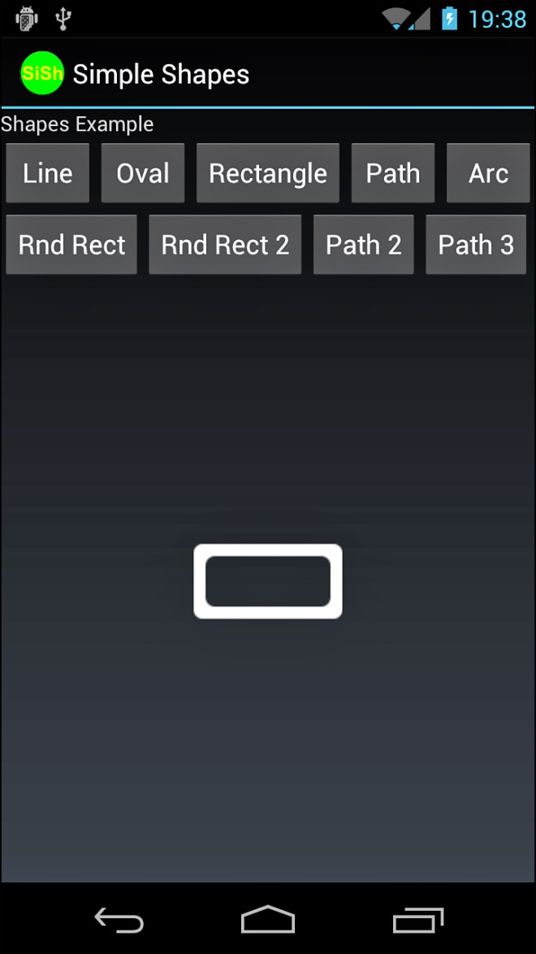
Drawing Rectangles with Rounded Corners
Notes:
The resulting round rectangle with an inset rectangle is shown in this figure.

Slide 50
Drawing Ovals and Circles
import android.graphics.drawable.ShapeDrawable;
import android.graphics.drawable.shapes.OvalShape;
...
ShapeDrawable oval = new ShapeDrawable(new OvalShape());
oval.setIntrinsicHeight(40);
oval.setIntrinsicWidth(100);
oval.getPaint().setColor(Color.RED);
ImageView iView = (ImageView)findViewById(R.id.ImageView1);
iView.setImageDrawable(oval);
Notes:
You can create ovals and circles (which are ovals with equal height/width values) by creating a ShapeDrawable using an OvalShape object. The OvalShape object has no dimensions but is bound by the container object—in this case, the ShapeDrawable. You can set some basic properties of the ShapeDrawable, such as the Paint color and the default size. For example, here we create a red oval that is 40 pixels high and 100 pixels wide, which looks like a Frisbee.

Slide 51
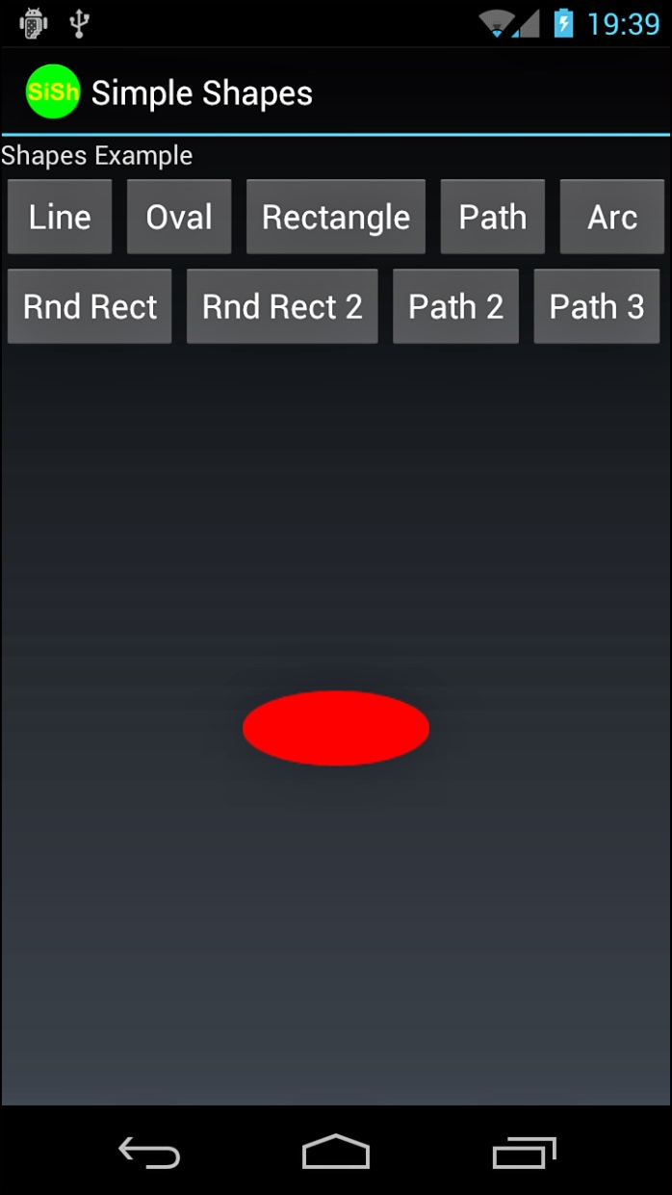
Drawing Ovals and Circles
Notes:
The resulting red oval is shown in this figure.

Slide 52
Drawing Arcs
import android.graphics.drawable.ShapeDrawable;
import android.graphics.drawable.shapes.ArcShape;
...
ShapeDrawable pacMan = new ShapeDrawable(new ArcShape(45, 270));
pacMan.setIntrinsicHeight(100);
pacMan.setIntrinsicWidth(100);
pacMan.getPaint().setColor(Color.MAGENTA);
ImageView iView = (ImageView)findViewById(R.id.ImageView1);
iView.setImageDrawable(pacMan);
Notes:
You can draw arcs, which look like pie charts or Pac-Man, depending on the sweep angle you specify. You can create arcs by creating a ShapeDrawable using an ArcShape object. The ArcShape object requires two parameters: a startAngle and a sweepAngle. The startAngle begins at 3 o’clock. Positive sweepAngle values sweep clockwise; negative values sweep counterclockwise. You can create a circle by using the values 0 and 360.
This code creates an arc that looks like a magenta Pac-Man.

Slide 53
Drawing Arcs
Notes:
The resulting arc is shown in this figure.

Slide 54
Drawing Paths
import android.graphics.Path;
...
Path p = new Path();
p.moveTo(50, 0);
p.lineTo(25,100);
p.lineTo(100,50);
p.lineTo(0,50);
p.lineTo(75,100);
p.lineTo(50,0);
Notes:
You can specify any shape you want by breaking it down into a series of points along a path. The android.graphics.Path class encapsulates a series of lines and curves that make up some larger shape.
For example, this Path defines a rough five-point star shape.

Slide 55
Drawing Paths
import android.graphics.drawable.ShapeDrawable;
import android.graphics.drawable.shapes.PathShape;
...
ShapeDrawable star = new ShapeDrawable(new PathShape(p, 100, 100));
star.setIntrinsicHeight(100);
star.setIntrinsicWidth(100);
star.getPaint().setColor(Color.YELLOW);
Notes:
You can then encapsulate this star Path in a PathShape, create a ShapeDrawable, and paint it yellow.

Slide 56
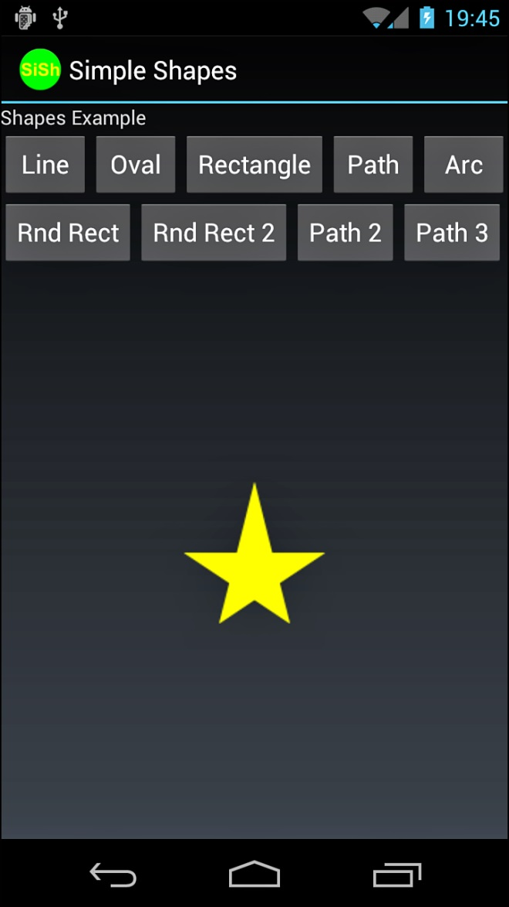
Drawing Paths
Notes:
By default, this generates a star shape filled with the Paint color yellow.

Slide 57
Drawing Paths
star.getPaint().setStyle(Paint.Style.STROKE);
Notes:
Or, you can set the Paint style to STROKE for a line drawing of a star.

Slide 58
Drawing Paths
Notes:
The resulting star would look something like this figure.

Slide 59
Leveraging Hardware Acceleration Features
Just about every Android application draws on the screen in some form or another.
Whether you’re using standard View controls or custom drawing, 2D hardware acceleration can improve your application.
Android developers can easily harness the built-in hardware acceleration features added to the Android platform in Android 3.0 from within their applications.
These newer versions of the Android platform boast an improved OpenGL rendering pipeline for common 2D graphics operations.
There’s little reason not to leverage hardware acceleration for a smoother, more responsive experience for your users.
You can simply take advantage of the default features, or you can fine-tune your application graphics acceleration at the application, Activity, Window, or View level, if required.

Slide 60
Controlling Hardware Acceleration
Hardware acceleration is available on devices running Android 3.0 and higher.
In fact, if your application has a minSdkVersion or targetSdkVersion set to API Level 14 or greater, hardware acceleration is enabled for all windows.
You may still want to control acceleration in your application.
This can be done directly in the manifest file in the <application> and <activity> tags.
Set the android:hardwareAccelerated attribute to true or false, depending on your needs.
To control acceleration at the Window or even for a specific View instance, you need to do this programmatically.
For the Window, use the setFlags() method with WindowManager.LayoutParams.FLAG_HARDWARE_ACCELERATED to enable acceleration.
There is no programmatic way to disable acceleration.
For a View control, use the setLayerType() method with the appropriate layer type, such as View.LAYER_TYPE_HARDWARE.

Slide 61
Fine-Tuning Hardware Acceleration
If you’ve got custom drawing operations or work with the Canvas and Paint classes in your application, you need to pay attention to which features are available in Android hardware acceleration at this time.
Certain Canvas and Paint operations are not currently supported, whereas others behave differently depending on hardware versus software acceleration.
Notably, the methods clipPath(), clipRegion(), drawPicture(), drawVertices(), drawPosText(), and drawTextOnPath() are not supported in the Canvas class.
In the Paint class, setLinearText(), setMaskFilter(), and setRasterizer() are not supported.
Test your app thoroughly, and if you run into problems, you’ve got a couple of options.
You can work around any problems by re-implementing your drawing code using supported functionality.
You can also turn off hardware acceleration on that Activity, Window, or specific View control and rely on the default software acceleration instead.

Slide 62
Chapter 22 Summary
We have learned about drawing on the screen.
We have learned how to work with text.
We are now able to work with bitmaps.
We have learned how to work with shapes.
We have learned how to leverage hardware acceleration features.
Notes:
Class homework assignment: Chapter Quiz Questions and Exercises listed at the end of the chapter.

Slide 63
References and More Information
Android SDK Reference documentation for the android.graphics package:
http://d.android.com/reference/android/graphics/package-summary.html
Android SDK Reference documentation for the Bitmap class:
http://d.android.com/reference/android/graphics/Bitmap.html
YouTube Android Developers Channel: “DevBytes: Bitmap Allocation”:
http://www.youtube.com/watch?v=rsQet4nBVi8
YouTube Android Developers Channel: “Bitmap Scaling”:
http://www.youtube.com/watch?v=12cB7gnL6po
Android API Guides: “Hardware Acceleration”:
http://d.android.com/guide/topics/graphics/hardware-accel.html

